Slide 1
SEO vs. SEM
MARCH 2018

Slide 2
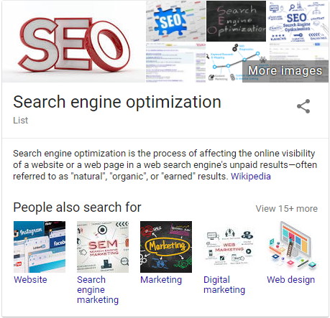
WHAT IS SEO / SEM?
Search Engine Optimization
Search engine optimization is the process of affecting the online visibility of a website or a web page in a search engine's unpaid results.
Search Engine Marketing
Search engine marketing is a form of marketing that involves the promotion of websites in search engine results pages primarily through paid advertising.

Slide 3
TOP SEOs
Matt Cutts
Distinguished Engineer, Google
Rand Fishkin
Founder and Ex-CEO, Moz
Founder, SparkToro
@mattcutts
@randfish

Slide 4
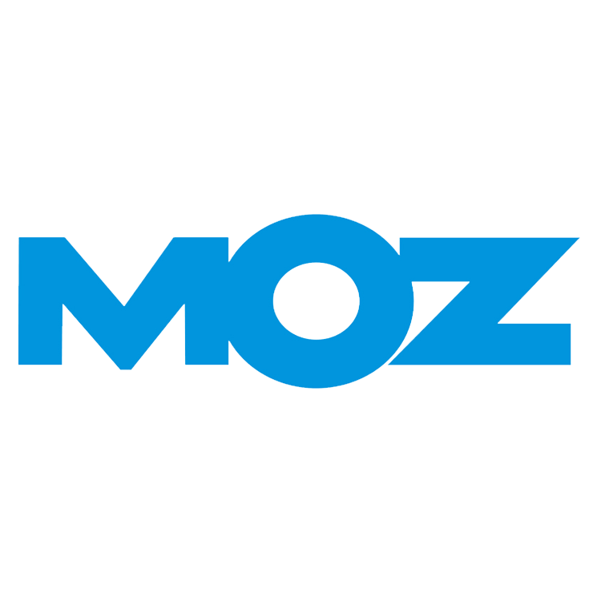
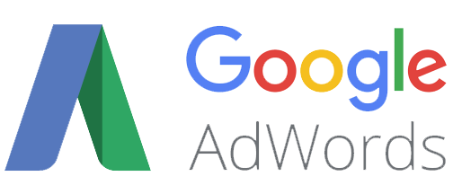
SEO / SEM COMPARISON
 | SEO | SEM
SPEED | Slow | Agile
BUDGET | None | Allocated
PLATFORMS
ALGORITHM | 200+ Factors | <10 Factors
KEYWORDS | National / Local | National / Local
TRAFFIC BASED ON | Ranking / Search Volume | Budget / Strategy

Slide 5
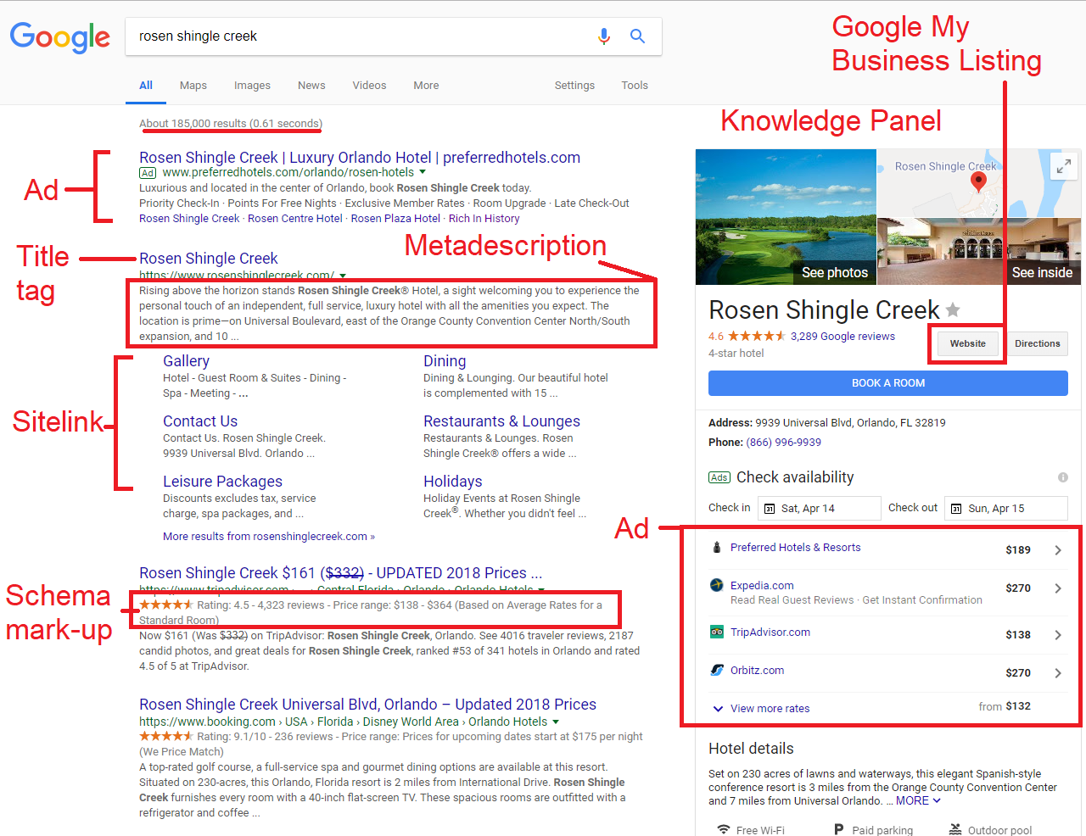
ANATOMY OF A SERP – ANALYSIS
Typically 10 organic results per page. Who goes past the first page? Who goes past the first 3 organic results?
In the hotel space, what is the most important thing to Google?
Do you care that there are 185,000 results? Do you need to know the page loaded in .61 seconds?
Historically, Google is pushing ads harder, drawing less importance to organic results (more money to Google).

Slide 6
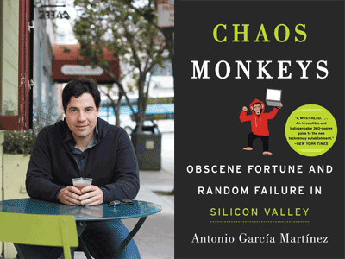
DOES ANYONE CLICK ON ADS? (SEM)
“How does Google manage to generate yearly revenues of $70 billion, greater than the GDP of Luxembourg or Belarus? It invented this magical website called Google Search where all of humanity goes and tells Google what it wants: “Nikon D300 camera.” “Online nursing degree.” “Divorce lawyer in Atlanta.”...
...It (Google) doesn’t even need to figure out what a search query is worth...It simply holds an auction for every search query entered, at the moment the query occurs...billions of times a day, Google runs an auction of keywords and accompanying bids...Actually printing physical money would be harder.”
Antonio Garcia Martinez, Product Manager, Facebook Chaos Monkeys

Slide 7
COMPLEXITY OF THE ALGORITHM (SEO)
How Google makes improvements to its search algorithm
Your Favorite Brand? Whatever Google or Amazon Says
Ranking Local Businesses Based Upon Quality Measures including Travel Time
Scott Galloway: In Marketing, Creepy Means Relevant
Moz - Timeline of Google’s Algorithm Revisions
SEORoundtable - Google: Focused Search Updates Daily & Core Updates Every Other Month

Slide 8
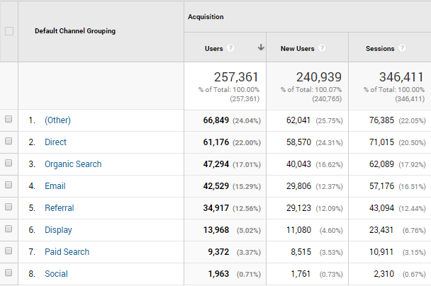
HOW MUCH IS OUR ORGANIC TRAFFIC (SEO) WORTH?
The month of January saw 60,000 sessions initiated from organic traffic with a total revenue of $810,00.
If this were an SEM campaign we would’ve spent $150,000¹.
Since this came through the organic search channel all this traffic was free.
¹ Based on average CPC of $2.5

Slide 9
COMPETITIVE SEARCH ANALYSIS (FEBRUARY)
 | SEO (Visits) | SEM (Visits) | Pages | Backlinks
 | 122.0M | 2.2M | 35.0M | 1.7M
 | 189.2K | 25.0K | 1.5K | 34.0K
 | 108.6K | 30.6K | 9.3K | 50.0K
 | 42.0K | 12.6K | 8.8K | 60.0K

